Slide 1

DNA Base-calling Project
2021/12/21
Cheng-Yu Hung

Slide 2
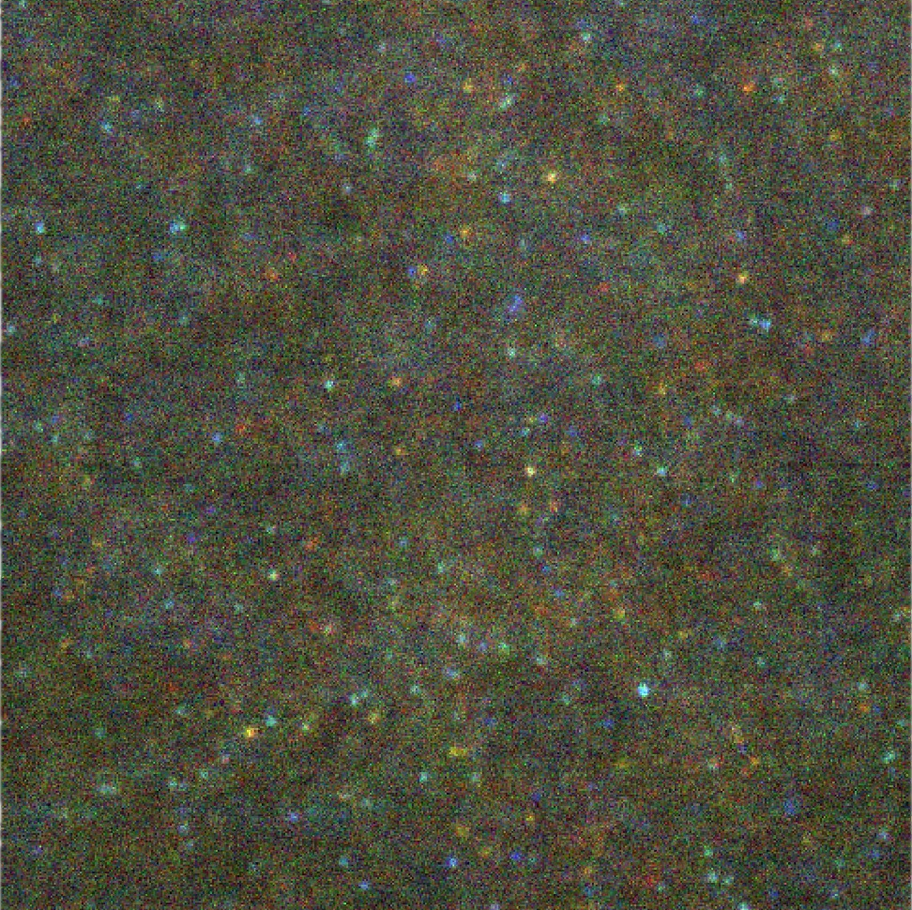
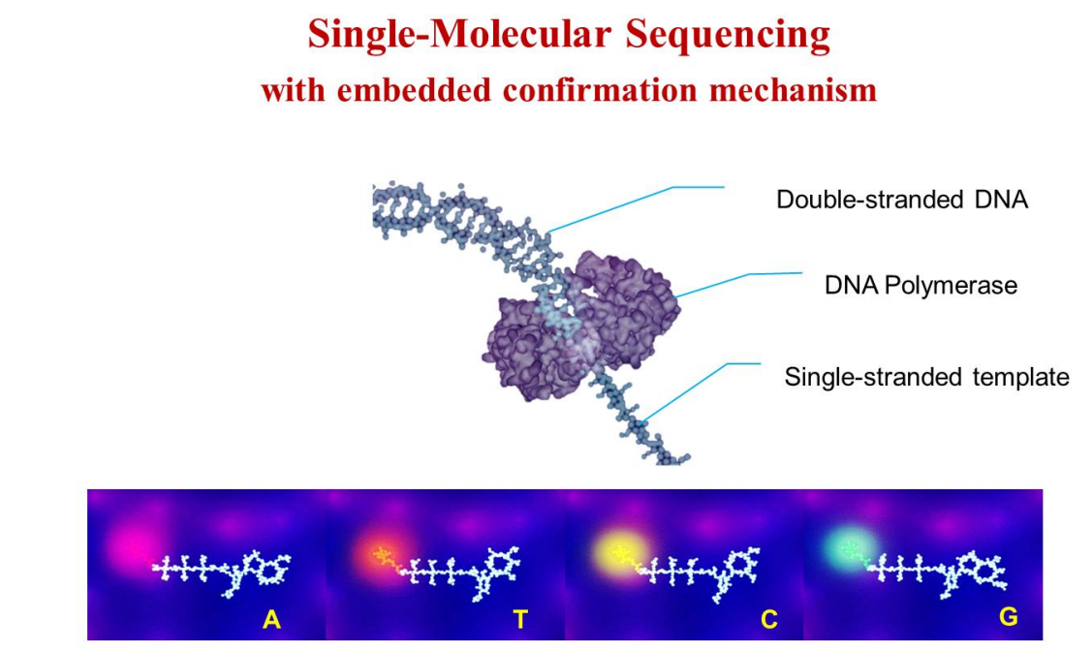
Optical System overview

Slide 3
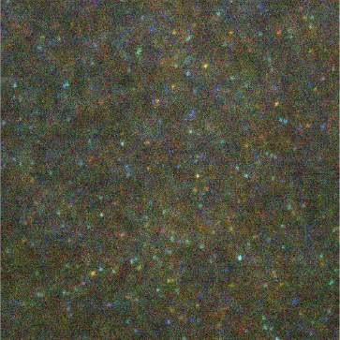
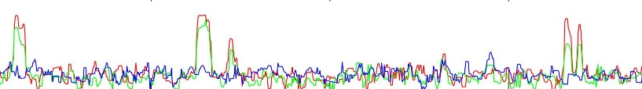
Algorithm Overview
1. Find Candidates
and get trace

Slide 4
Algorithm Overview
1. Find Candidates
and get trace
2. Designate DNA Label(ATCG)

Slide 5
1. Get candidate Workflow
(A) Shift adjustment
(B) Denoise image
(C) Pick candidates
(D) Get Trace

Slide 6
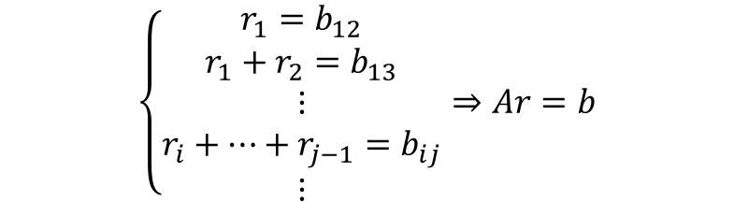
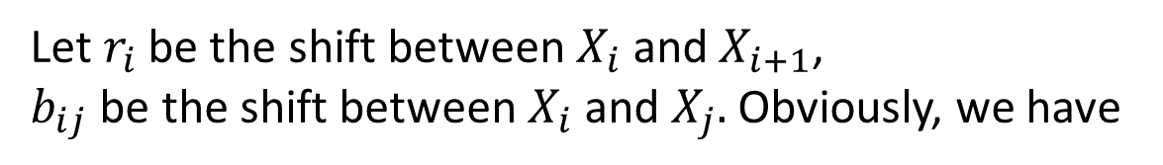
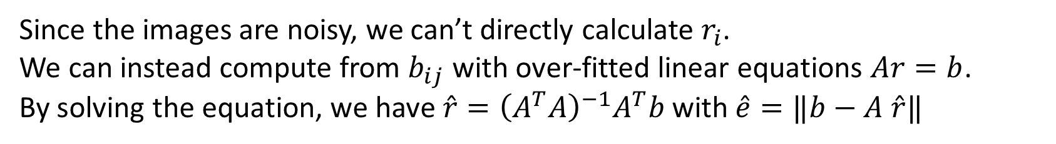
(A) Shift adjustment
(A)
Because the images have a slightly shift, I need to make some preprocessing on the images.
I use the same method in motion corr 2, as below
Let $r_{i}$ be the shift between $X_{i}$ and $X_{i+1}$,
$b_{ij}$ be the shift between $X_{i}$ and $X_{j}.$ Obviously, we have
(B)
$$\left\{\begin{aligned}r_{1}=b_{12} \\ r_{1}+r_{2}=b_{13} \\ ⋮ \\ r_{i}+⋯+r_{j−1}=b_{ij} \\ ⋮\end{aligned}⇒Ar=b\right.$$
(C)
Since the images are noisy, we can’t directly calculate $r_{i}$.
We can instead compute from $b_{ij}$ with over-fitted linear equations $Ar=b$.
By solving the equation, we have $\hat{r}={\left(A^{T}A\right)}^{−1}A^{T}b$ with $\hat{e}=‖b−A \hat{r}‖$
(D)

Slide 7
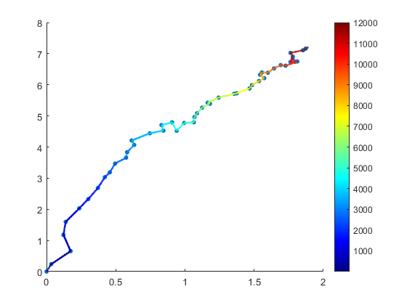
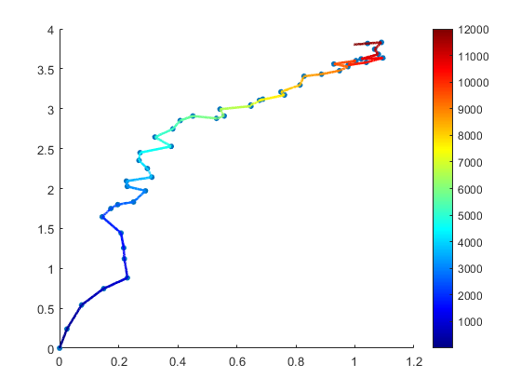
(A) Shift adjustment -Result
(A)
A03
A04
(B)
(C)
(D)

Slide 8
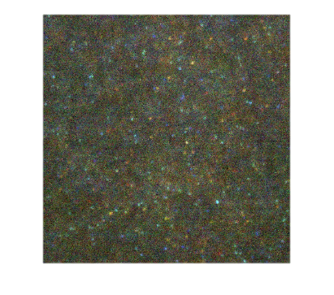
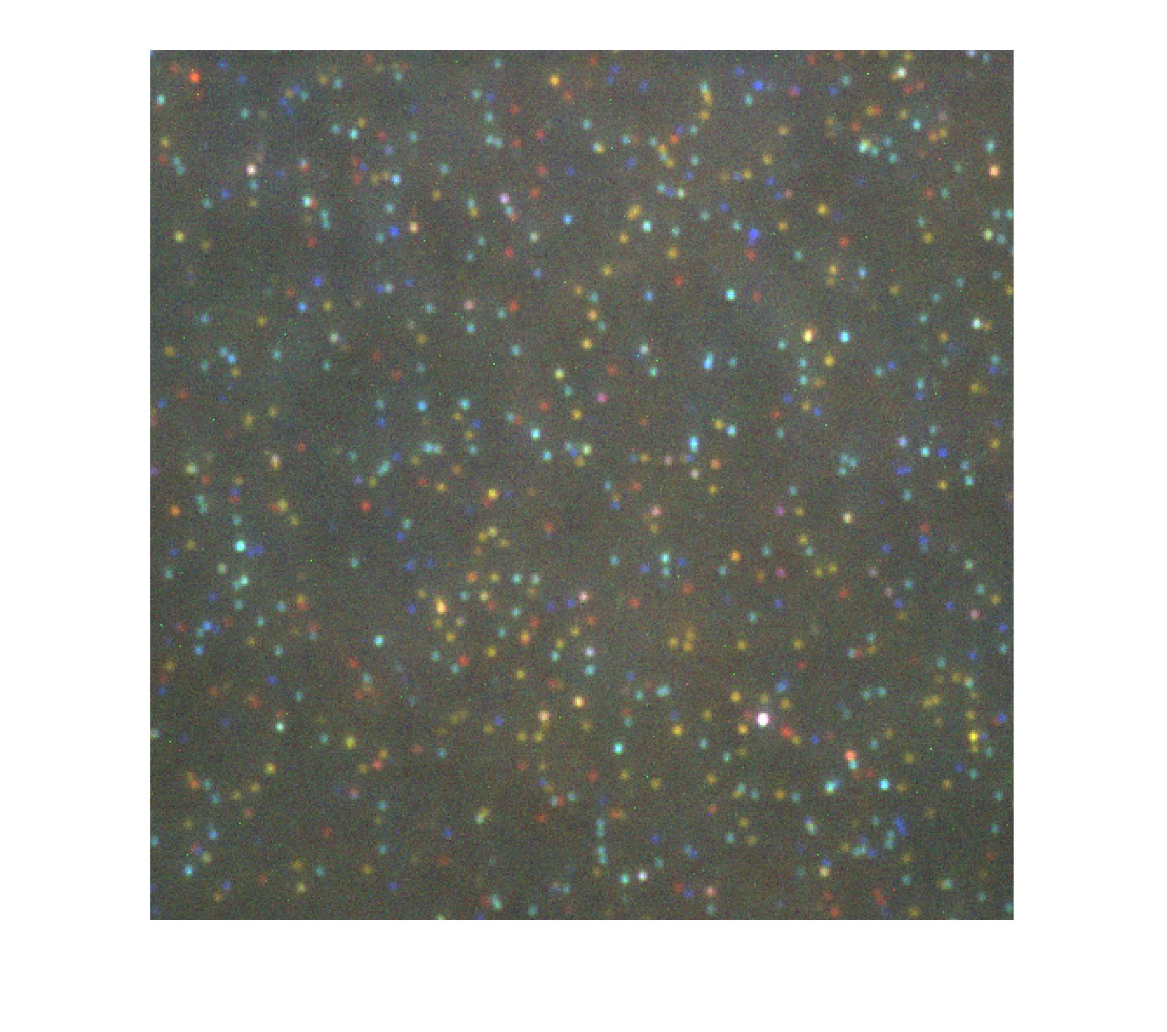
(B) Denoise image
(A)
(B)
(C)
Bin for every 5 frames
(D)

Slide 9
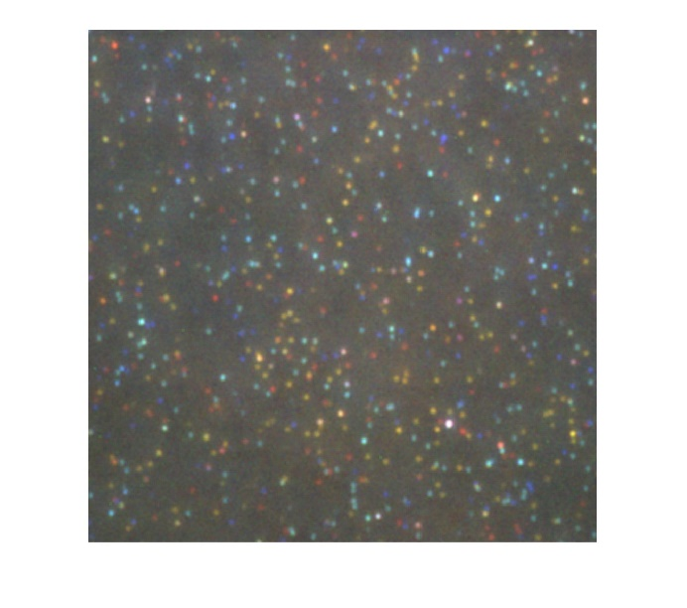
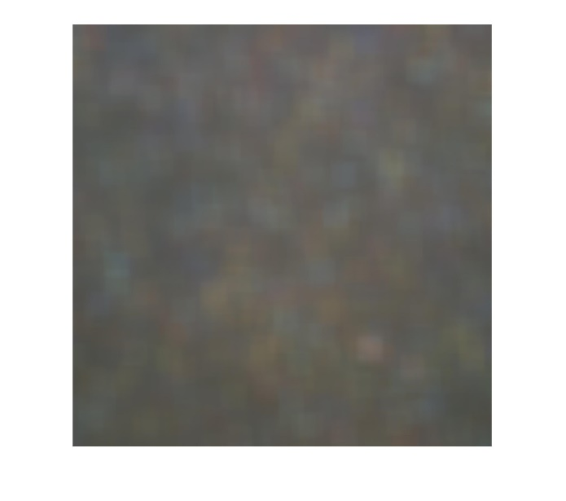
(B) Denoise image
(A)
Conv w/ 3x3 avg
(B)
Subtract
(C)
Conv w/ 30x30 avg
(D)

Slide 10
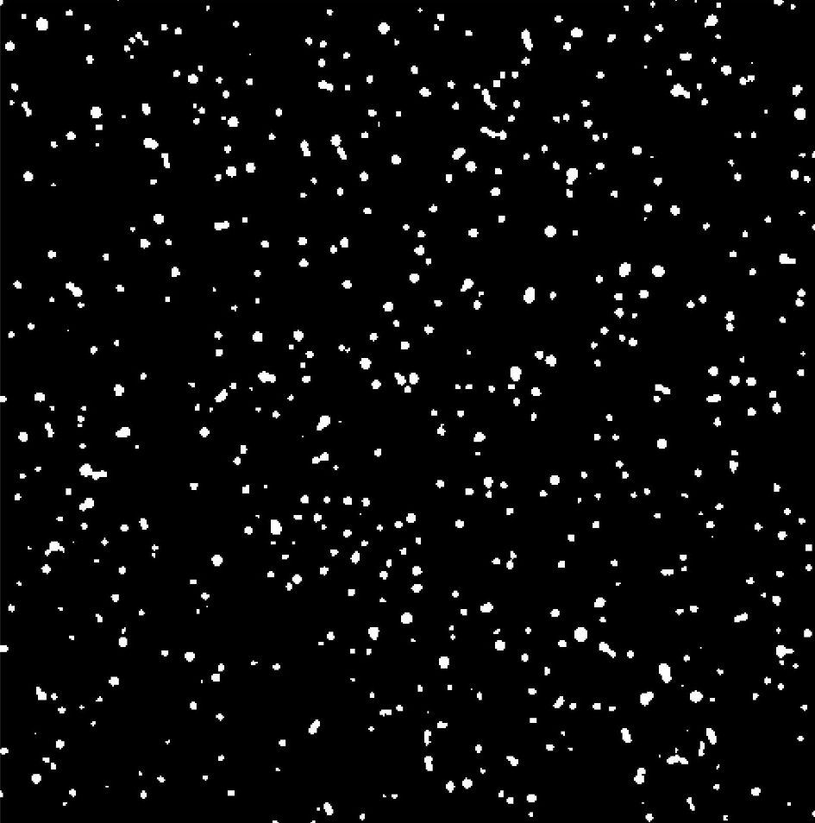
(B) Denoise image
(A)
(B)
Applying OTSU threshold
(C)
(D)

Slide 11
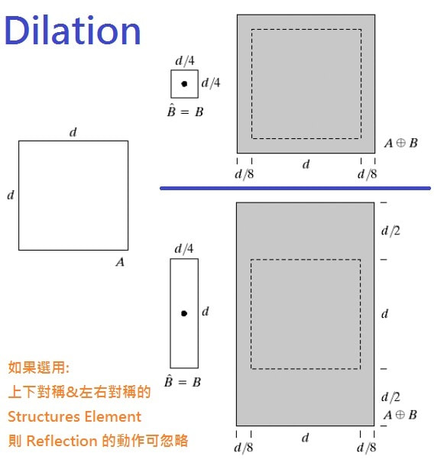
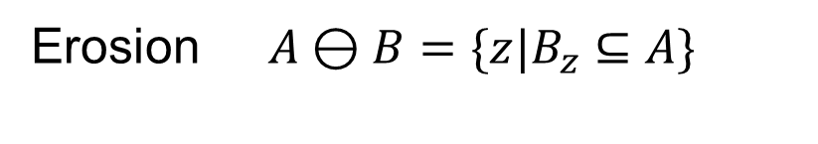
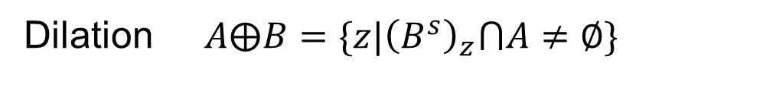
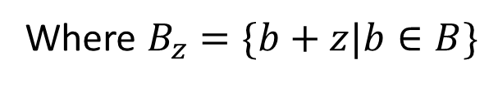
(B) Denoise image - Morphology
(A)
Dilation $A⨁B=\{z|{\left(B^{s}\right)}_{z}⋂A≠∅\}$
Where $B_{z}=\{b+z|b∈B\}$
Erosion $A⊖B=\{z|B_{z}⊆A\}$
(B)
Dilation
(C)
(D)

Slide 12
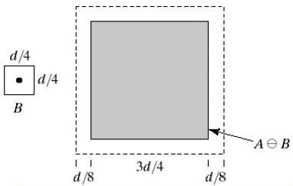
(B) Denoise image - Morphology
(A)
Dilation $A⨁B=\{z|{\left(B^{s}\right)}_{z}⋂A≠∅\}$
Where $B_{z}=\{b+z|b∈B\}$
Erosion $A⊖B=\{z|B_{z}⊆A\}$
(B)
Erosion
(C)
(D)

Slide 13
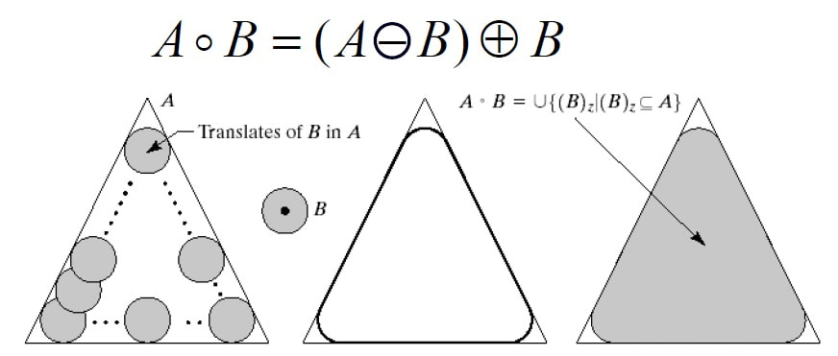

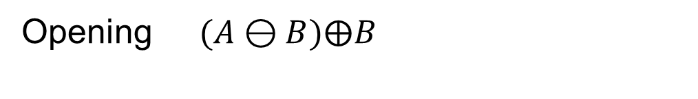
(B) Denoise image - Morphology
(A)
Opening $(A⊖B)⨁B$
Closing $(A⨁B)⊖B$
(B)
Opening
(C)
(D)

Slide 14
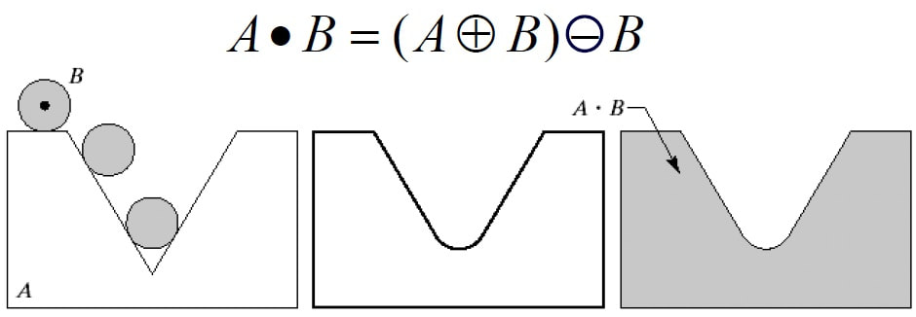
(B) Denoise image - Morphology
(A)
Opening $(A⊖B)⨁B$
Closing $(A⨁B)⊖B$
(B)
Closing
(C)
(D)

Slide 15
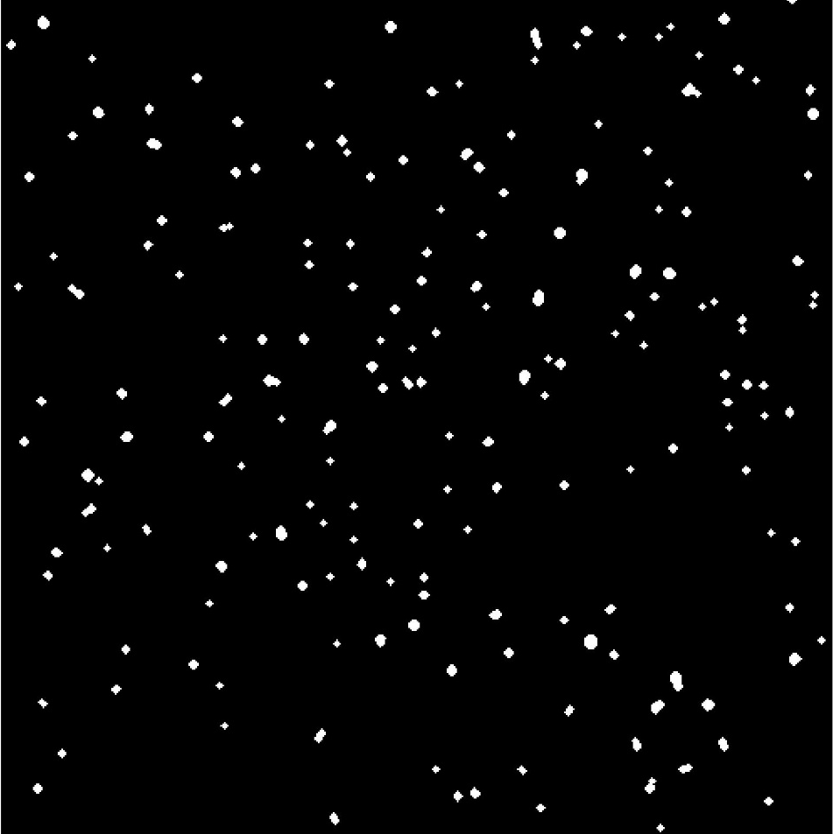
(B) Denoise image
(A)
(B)
(C)
Doing Opening (morphology)
(D)
Binary image
Clean Spot image

Slide 16
(B) Denoise image
(A)
(B)
(C)
(D)
Original image
Clean Spot image

Slide 17
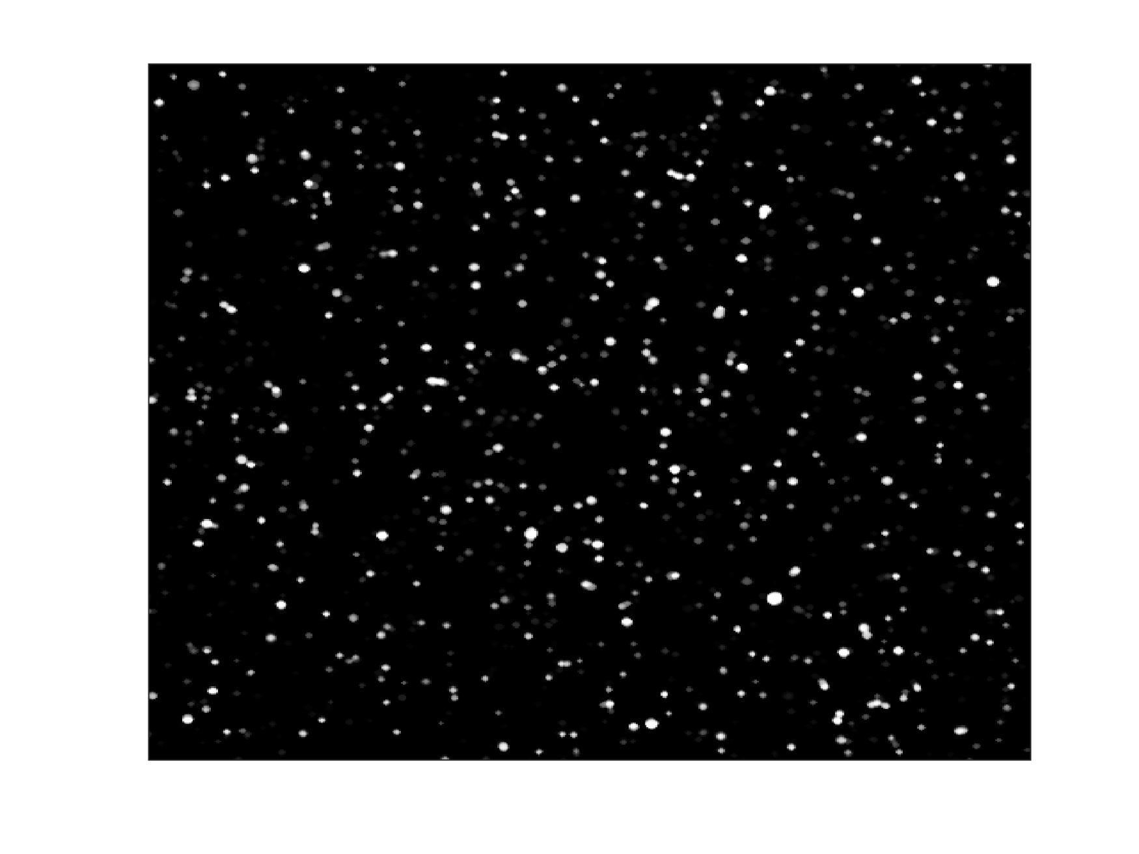
(C) Pick candidates
(A)
(B)
Summation
(C)
(D)
Clean Spot images

Slide 18
(C) Pick candidates
(A)
Find the center
(B)
Filter out those points that are bright constantly.
(C)
(D)

Slide 19
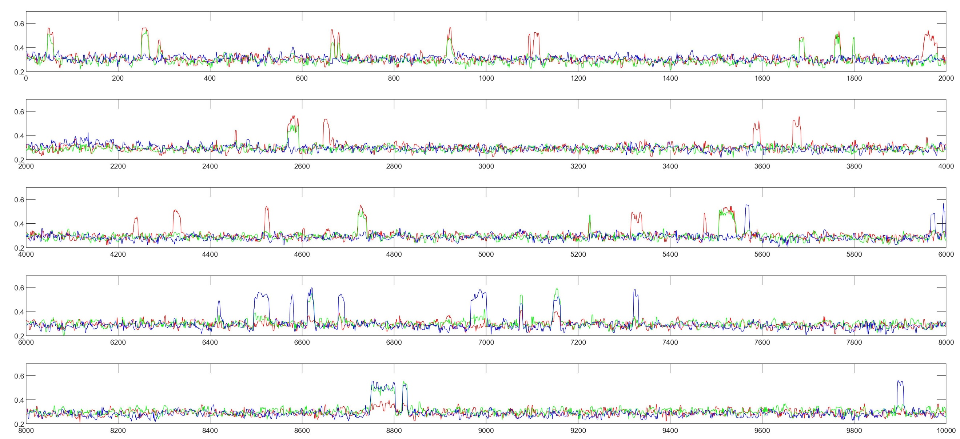
(D) Get Trace
(A)
(B)
(C)
(D)

Slide 20
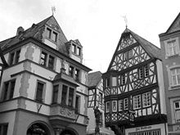
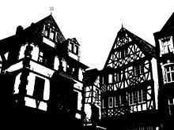
Appendix OTSU method
This threshold is determined by minimizing intra-class intensity variance, or equivalently, by maximizing inter-class variance.
OTSU is equivalent to a globally optimal k-means performed on the intensity histogram.

